Slide 1



iXBRL report indexer with integrity & non-repudiation secured by Blockchain
Ignacio Boixo
Javier Mora
Jesús Ruiz
Seville, 21st March 2019

Slide 2




Publication today
Issuer
Report
Supervisor
PublicationWeb
← Query?
Anna
Report
Reports’
Supply
Chain
Unaudited Report
Audited Report
PublicationWeb
Report
Bob
Auditor
Report
← Query?
OAM
Integrity?
Non-Repudiation ?
Carol
Report

Slide 3
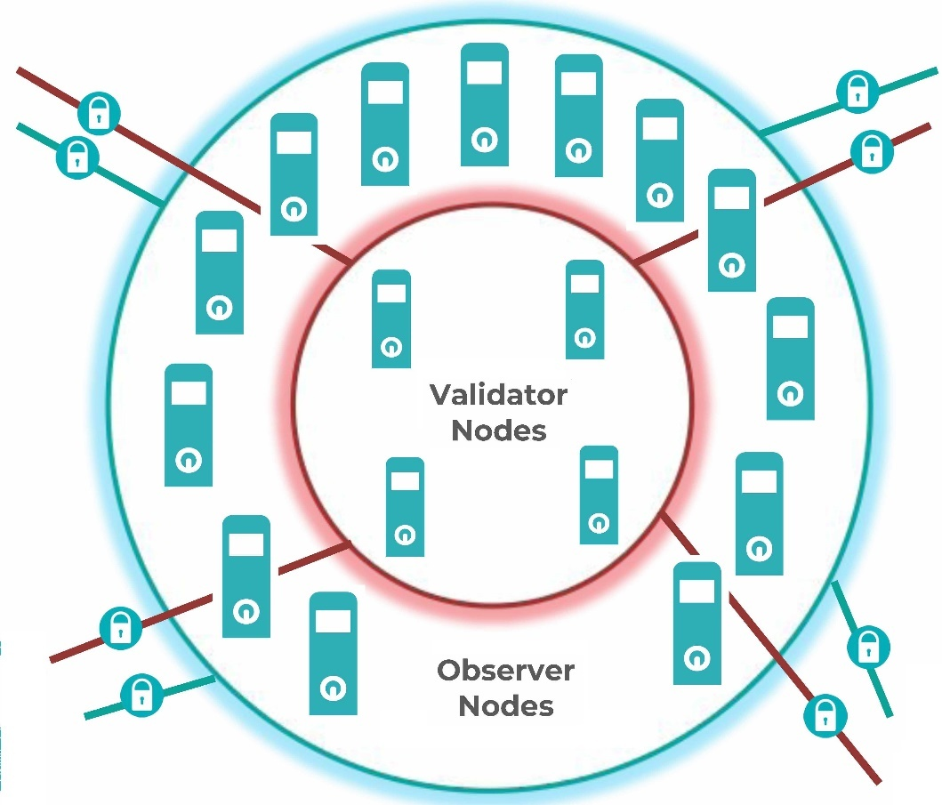
Integrity & Non-Repudiation
Issuer
Report
Supervisor
Notarize
Hash
PublicationWeb
← Query?
Anna
Report
Notarize
Hash
Reports’
Supply
Chain
Unaudited Report
Audited Report
Notarize
Hash
Notarize
Hash
Bob
PublicationWeb
Report
Auditor
Check
Hash
Report
← Query?
OAM
← Check Report’s Hash
Integrity, Non-Repudiation →
Carol
Report
Check Server

Slide 4
Global Simultaneity
Issuer
Report
Supervisor
Notarize
Hash, URL
PublicationWeb
← Query?
Anna
Report
URL?↑
← URL?
Notarize
Hash, URL
Report
Report
Reports’ Index
David
Reports’
Supply
Chain
Unaudited Report
Audited Report
Add URL
Financial Gateway
←Query?
URL list→
Event →
Notarize
Report
Report
URL?↓
← URL?
Notarize
Hash
Notarize
Hash, URL
Bob
PublicationWeb
Report
Auditor
Report
← Query?
Event ↓
Notarize
Check Hash
OAM
← Check Report’s Hash
New Report Alert, Integrity, Non-Repudiation →
Carol
Report
Check Server

Slide 5
DEMO

